Slide 1
Distributed Information Systems Fall Semester – 2021 CS-423 Time and Place Lecture: Monday 13:15-15:00, BCH 2201 https://epfl.zoom.us/j/65956515720 Exercise: Monday 15:15-16:00, BCH 2201
Karl Aberer
Distributed Information Systems Laboratory

Slide 2
Welcome to (another) Special Semester!
Everything is different
We will be working in hybrid mode
Program of today:
Hour 1: Everything you need to know on the organization
Hour 2: An overview of main concepts that will be covered during the semester

Slide 3
Goals of the Course
Understand what is a "Distributed Information System"?
e.g. Web Search Engines, Online Social Networks, etc.
Know which are key tasks relevant for DIS?
e.g. retrieval, mining, recommending, information extraction, data integration etc.
Master common techniques used to solve these problems
e.g. vector space model, graph mining, word embeddings etc.
Pre-existing knowledge not required
Knowledge in databases and machine learning helpful

Slide 4
Focus of the Course
Master important Models and Algorithms for representing and processing information:
Data Science
Conceptual foundations to practically use tools and platforms for Data Science
Complementary to Applied Data Analysis by Bob West

Slide 5
Other Related Courses
In synergy with
Applied Data Analysis
Complementary to
Introduction to database systems
Database systems
Some overlaps possible with
Introduction to machine learning
Machine learning
Introduction to natural language processing
Internet analytics

Slide 6
Which masters program are you from?
Computer Science
Communications
Data Science
Cybersecurity
Digital Humanities
Life Science
Electrical Engineering
Environmental Science
Others

Slide 7
Did you take Applied Data Analysis?
Yes
No

Slide 8
The Course - Lecture
Live lecture will be transmitted via webinar https://epfl.zoom.us/j/65956515720
Standard online ex cathedra lecture
Use QA tool to ask questions
Will be answered privately by assistants, or by the lecturer, depending on the questions
Quizzes using Zoom (anonymous)
Video recordings https://tube.switch.ch/channels/zireVjctlC

Slide 9
Materials
Web platform: Moodle
General announcements will be published on Moodle
Course notes and exercises will be published on the Web in advance: https://lsir.github.io/DIS/

Slide 10
Exercises
Weekly exercises
2-3 problems to solve
Most problems will be (simple) programming exercises
Uses Python
Focus on understanding the techniques (not programming skills etc)
Exercises and exam questions from previous years will be made available as well

Slide 11
Exercise Platform
We will be using Zoom for communicating with assistants during exercises
In addition, we will use Piazza for posing questions and discussions
Both among students and with assistants

Slide 12
“Continuous control”
Due to the current situation not clear whether graded continuous control is possible
But
Midterm programming exercise
2 Quizzes
Will allow to test your skills

Slide 13
Grading
Final Exam: 100% or 75% (depending on rules)
Questions similar to the question in exercises and quizzes
will assume you attended the lecture
will assume you did the exercises
examples from earlier years (exercises, exams) provided for preparation

Slide 14
Exam Support
Your computer will be admitted to the exam
You will have Internet access
But: communication not allowed (messaging, social platform etc.)
You can use your notes (paper of electronically, all lecture materials)

Slide 15
Are you planning to join the lecture live or virtually?
I join live today, and plan to continue live
I join live today, but plan to join virtually
I join virtually today, and plan to continue virtually
I join virtually today, but plan to join live

Slide 16
Schedule
Week | Date | Cont. Eval. | Area | Topic
1 | 20 September 2021 |  |  | Holiday
2 | 27 September 2021 |  | Introduction | Distributed Information Systems - An Overview
3 | 04 October 2021 |  | Information Retrieval | Basic Text Retrieval Models
4 | 11 October 2021 |  |  | Probabilistic Retrieval and Relevance Feedback
5 | 18 October 2021 | Prog. midterm |  | Indexing and Distributed retrieval
6 | 25 October 2021 |  |  | Word Embeddings
7 | 01 November 2021 |  |  | Link-based ranking
8 | 08 November 2021 |  | Data Mining | Graph Mining
9 | 15 November 2021 | Quiz |  | Document classification
10 | 22 November 2021 |  |  | Recommender Systems
11 | 29 November 2021 |  |  | Association Rules
12 | 06 December 2021 |  | From Documents to Knowledge | Semantic Web
13 | 13 December 2021 | Quiz |  | Entity and Information Extraction
14 | 20 December 2021 |  |  | Inference for Knowledge Graphs

Slide 17

Lecturer

Slide 18
Organizational Info
Moodle
http://moodle.epfl.ch/course/view.php?id=4051
Lecturers
Prof. Karl Aberer karl.aberer@epfl.ch BC 108
Assistants
Romanou Angelika angelika.romanou@epfl.ch
Tugrulcan Elmas tugrulcan.elmas@epfl.ch
Mokhtarian Ehsan ehsan.mokhtarian@epfl.ch
Farhadkhani Sadegh sadegh.farhadkhani@epfl.ch

Slide 19
References
Parts of the course are based on the following text books
Ricardo Baeza-Yates, Berthier Ribeiro-Neto, Modern Information Retrieval (Acm Press Series), Addison Wesley, 1999.
Jiawei Han, Data Mining: concepts and techniques, Morgan Kaufman, 2000.
Christopher D. Manning, Prabhakar Raghavan and Hinrich Schütze, Introduction to Information Retrieval, Cambridge University Press. 2008.
J Leskovec, A Rajaraman, JD Ullman, Mining of Massive Datasets, 2014.
Further references to the literature will be given during the lecture

Slide 20
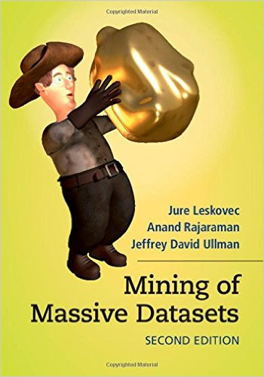
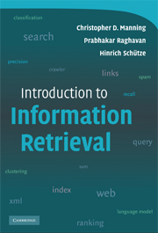
Free books
mmds.org
http://nlp.stanford.edu/IR-book/

Slide 21
Exam Date

